Slide 1
Collaborative AI – 236203 Intro to AI overview
Slides adapted from ai.berkeley.edu by
Dan Klein, Pieter Abbeel and Anca Dragan
and from Shaul Markovitz @ Technion

Slide 2

Today’s lecture
Progress in AI
The architecture of an intelligent agent
Problem-Solving Agents
Uninformed Search
Informed Search
MDPs
Notes:
Many you have seen before.
Unified formalism leading to A* search (search guided by heuristic)

Slide 3
Progress in AI

Slide 4
Humans vs. Computers
What tasks are computers clearly better than humans?
Arithmetic computation, systematic search, storing and retrieving data, boredom resistance, not pressurable, handling big data
What tasks are humans clearly better than computers?
World model, reasoning, language processing
What about
Image analysis, pattern recognition, learning

Slide 5
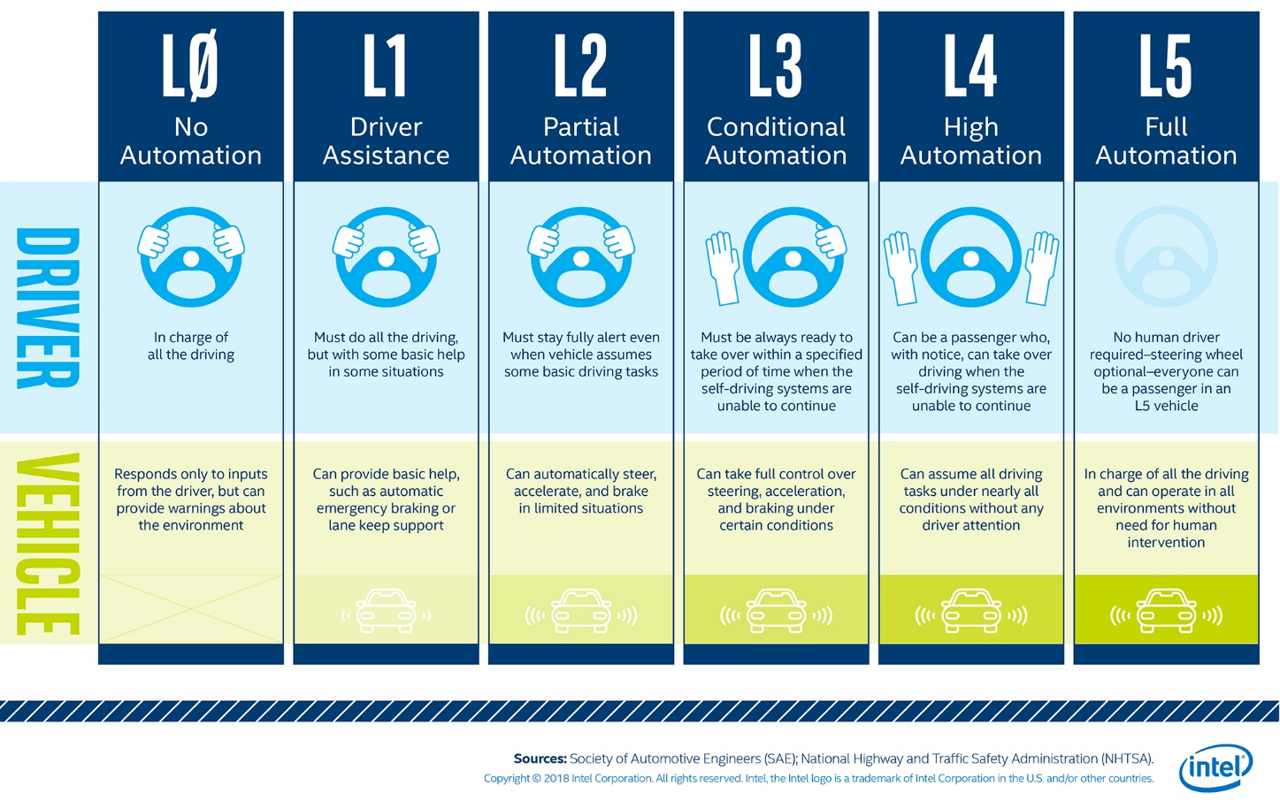
Autonomous agents (self-driving cars)

Slide 6

Autonomous agents (robotic surgery)
Adapted from http://surgrob.blogspot.com/2019/05/level-of-autonomy-for-surgical-robotics.html

Slide 7
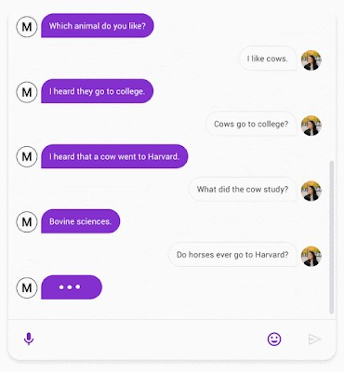
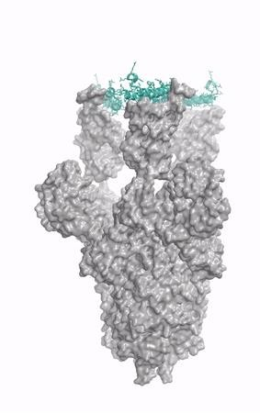

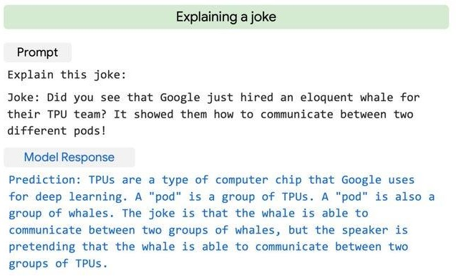
image credit: UW IPD

Slide 8

AI Application - Robotic control

Slide 9
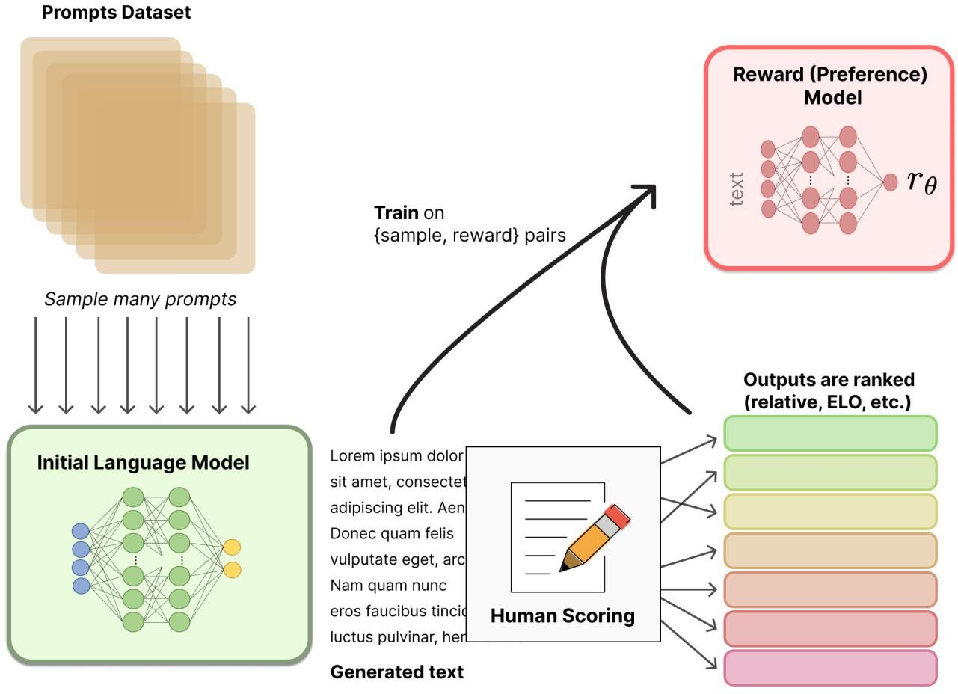
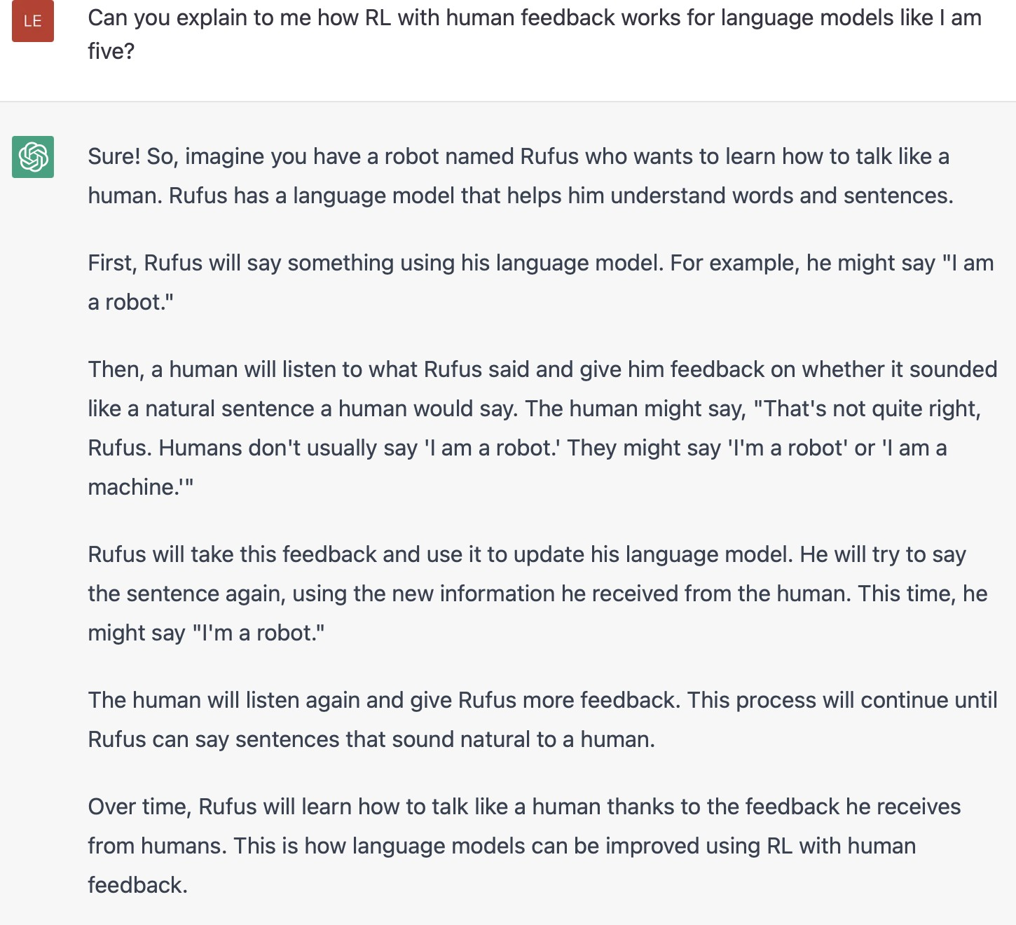
AI Application - language models

Slide 10
















RL Application - image generation
DDPO
(RL)
DDPO (RL)
DDPO (RL)
“a dolphin riding a bike”
Kevin Black*, Michael Janner*, Yilun Du, Ilya Kostrikov, Sergey Levine. Training Diffusion Models with Reinforcement Learning. 2023.

Slide 11
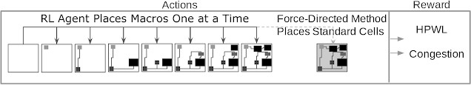
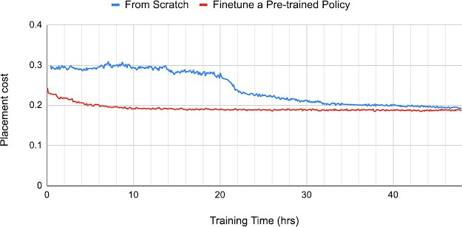
AI Application - chip design
Source: https://ai.googleblog.com/2020/04/chip-design-with-deep-reinforcement.html

Slide 12

AlphaGo - The Movie

Slide 13
Architecture of an autonomous intelligent agent

Slide 14
Rational Decisions
We’ll use the term rational in a very specific, technical way:
Rational: maximally achieving pre-defined goals
Rationality only concerns what decisions are made
(not the thought process behind them)
Goals are expressed in terms of the utility of outcomes
Being rational means maximizing your expected utility
Notes:
Not about building machines that don’t get angry
Example of utilities. 10 for A, 1 for each Friday with friends

Slide 15
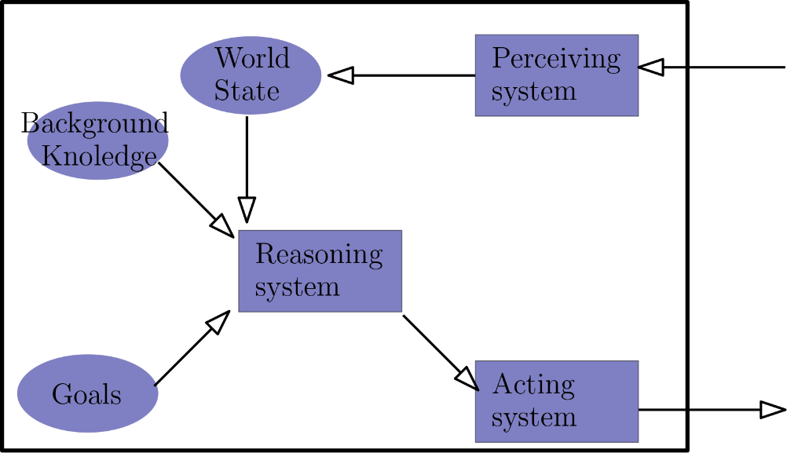

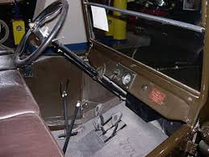
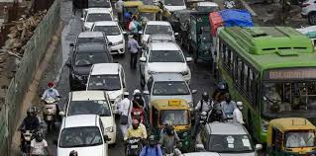
Rational agent
In a complex environment we can’t encode all state + goal pairs to actions
A rational agent uses its model of the word coupled with a reasoning system to plan a sequence of actions that will lead to the goal while maximizing its expected utility

Slide 16

Each one of the components of a rational agent is a subdiscipline in AI
ML
Computer Vision, NLP…
Reasoning, search
Robot design

Slide 17

What about more than one agent?
We often have more than one agent
Do they share the same goal? (Cooperative / competitive)

Slide 18
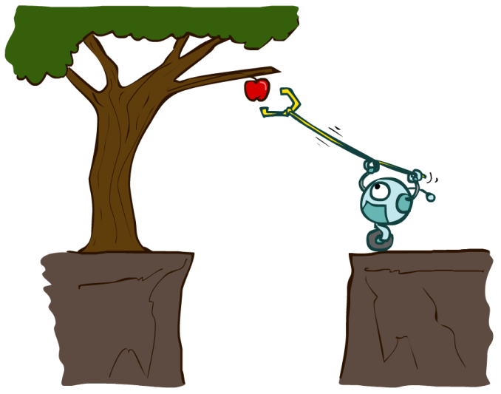
Designing Rational Agents
An agent is an entity that perceives and acts.
A rational agent selects actions that maximize its (expected) utility.
Characteristics of the percepts, environment, and action space dictate techniques for selecting rational actions
Sensors
Agent
Percepts
Environment
?
Actuators
Actions

Slide 19
How do we design the rational agent’s decision procedure?
An agent’s decision procedure maps a world’s state and a desired goal to an action
We can hardcode the mapping
May be an infinite table
We can hardcode the mapping
May (still) be an infinite table
This is called a reflex agent
Sensors
Agent
Percepts
Environment
?
Actuators
Actions

Slide 20
Problem-Solving Agents

Slide 21

How do we formalize a search problem?

Slide 22

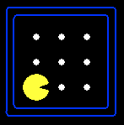





Search Problems
A search problem consists of:
A state space
A successor function
(with actions, costs)
or a set of operators
A start state and a goal test
A solution is a sequence of actions (a plan) which transforms the start state to a goal state
“N”, 1.0
“E”, 1.0
Notes:
Abstraction. Useful for later topics.
Goal test – sometimes more than one state that satisfies having achieved the goal, for example, “eat all the dots”

Slide 23
State-Space Graphs
L2
State-space graph: A mathematical representation of a search problem
Nodes are (abstracted) world configurations
Arcs represent successors (action results)
The goal test is a set of goal nodes (maybe only one)
In a state-space graph, each state occurs only once!
We can rarely build this full graph in memory (it’s too big), but it’s a useful idea
The graph may be infinite
The graph is given implicitly
Notes:
ASR (automatic speech recognition): every possible pronunciation of every possible sentence. Huge.

Slide 24

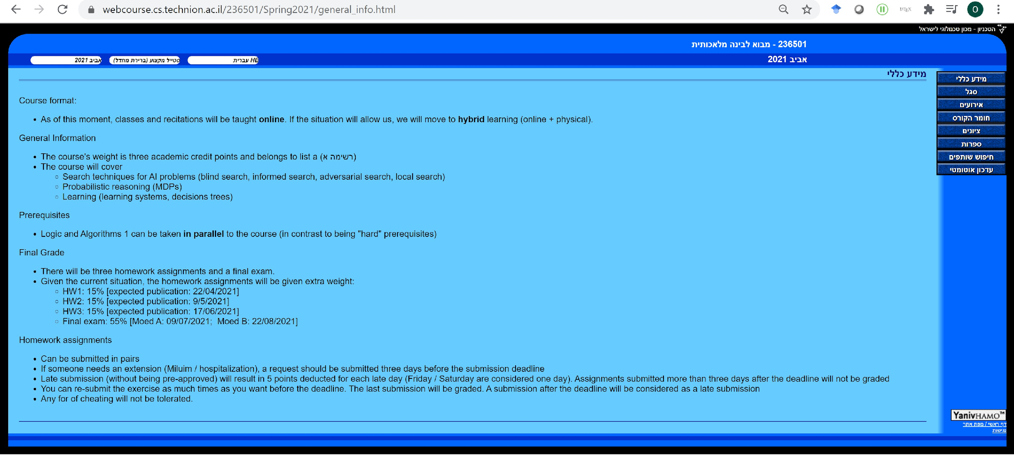
Example: searching the internet
Problem: Given the Technion’s homepage, find the series of clicks that will get you to the homepage of Intro To AI

Slide 25
Example: searching the internet
Problem: Given the Technion’s homepage, find the series of clicks that will get you to the homepage of Intro To AI
State space:

Slide 26
Example: searching the internet
Problem: Given the Technion’s homepage, find the series of clicks that will get you to the homepage of Intro To AI
State space: all URLs

Slide 27
Example: searching the internet
Problem: Given the Technion’s homepage, find the series of clicks that will get you to the homepage of Intro To AI
State space: all URLs
Successor function:

Slide 28
Example: searching the internet
Problem: Given the Technion’s homepage, find the series of clicks that will get you to the homepage of Intro To AI
State space: all URLs
Successor function: for each page the set of successors is defined by the links available at that page (cost = 1)

Slide 29
Example: searching the internet
Problem: Given the Technion’s homepage, find the series of clicks that will get you to the homepage of Intro To AI
State space: all URLs
Successor function: for each page the set of successors is defined by the links available at that page (cost = 1)
Start state:
Goal state:

Slide 30
Example: searching the internet
Problem: Given the Technion’s homepage, find the series of clicks that will get you to the homepage of Intro To AI
State space: all URLs
Successor function: for each page the set of successors is defined by the links available at that page (cost = 1)
Start state: https://www.cs.technion.ac.il/
Goal state: https://webcourse.cs.technion.ac.il/236501/

Slide 31
Example: searching the internet
Problem: Given the Technion’s homepage, find the series of clicks that will get you to the homepage of Intro To AI
State space: all URLs
Successor function: for each page the set of successors is defined by the links available at that page (cost = 1)
Start state: https://www.cs.technion.ac.il/
Goal state: https://webcourse.cs.technion.ac.il/236501/

Slide 32

Search Problems Are Models
Models aren’t perfect
Too detailed, you can’t solve
Not detailed enough, doesn’t solve

Slide 33
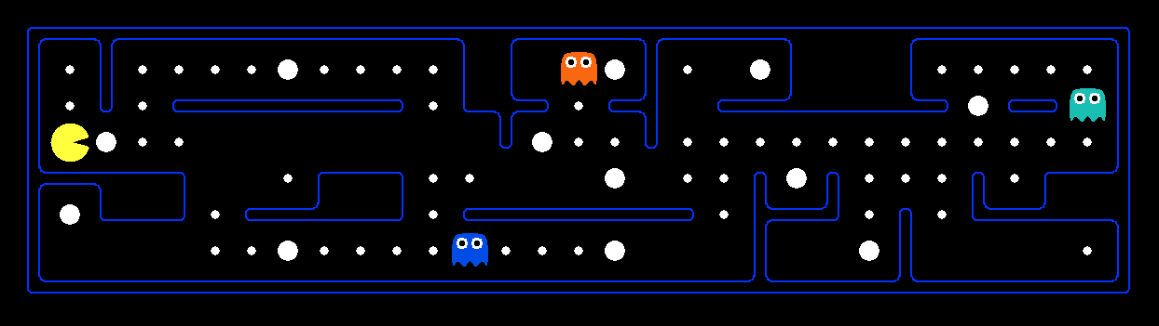
What’s in a State Space?
The world state includes every last detail of the environment
A search state keeps only the details needed for planning (abstraction)
Problem: Path finding
States: (x,y) location
Actions: NSEW
Successor: update location only
Goal test: is (x,y)=END
Problem: Eat-All-Dots
States: {(x,y), dot booleans}
Actions: NSEW
Successor: update location and possibly a dot boolean
Goal test: dots all false
Notes:
Wrong example for “eat-all-dots”: (x, y, dot count). Need bool.
World >= State
Walls? Part of successor.

Slide 34
Initial assumptions
Set of actions is finite and bounded by some constant
In practice, they are often parametrized and thus infinite (e.g., steering angle of a car)
In such settings we can discretize the set of actions
State of agent is observable
i.e., agent knows its state
Actions are deterministic
i.e., agent knows what will happen when it does something
We will relax some of these assumptions along the course
Notes:
12x10 grid

Slide 35
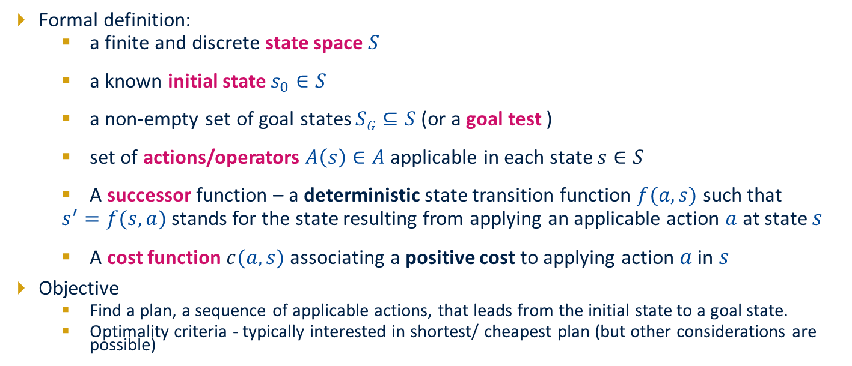
State Space Search Problem : Classical Planning

Slide 36

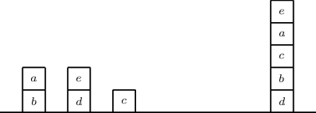
Factored State Space Definition: Using Features
Typically, it is not possible to explicitly specify the state space S
Instead, feature set X is used to represent the state space such that a state is described via a set of random variables X= x₁, . . . , x_{n} such that each variable takes on values in some finite domain Dom(x_{i}).
Can be Boolean or multi-valued
Example:
Position of block a
Position of block c
...
Is gripper empty

Slide 37
Formalizing a search problem

Slide 38
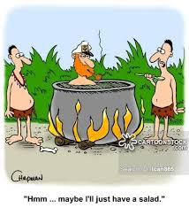
Example: Missionaries and cannibals problem
Problem:
3 missionaries and 3 cannibals must cross a river using a boat that carries at most 2 people
If there are missionaries present on the bank, they cannot be outnumbered by cannibals (if they were, the cannibals would eat the missionaries)
The boat cannot cross the river by itself with no people on board
How do we represent the search problem?

Slide 39

Example: Missionaries and cannibals problem
Take (1):
A state is a 7-tuple
location of person
location of boat
Start state:
Goal state:
How many states do we have?
Unnecessary information
We don’t care which missionary / cannibal is on which side
We don’t care about the state of the boat while crossing

Slide 40







Example: Missionaries and cannibals problem
Take (2):
A state is a 3-tuple
number of missionaries on left bank
number of cannibals on left bank
location of boat
Start state:
Goal state:
How many states do we have?

Slide 41


Informed Search
Uninformed (blind) Search – using only problem definition and no domain knowledge
DFS, BFS, UCS
Informed Search
Heuristics – some domain knowledge
Greedy Search
A* Search
Notes:
Blind search vs. “warmer” “colder”
Info about where goal is.
Optimal solution, explore less of the tree.

Slide 42
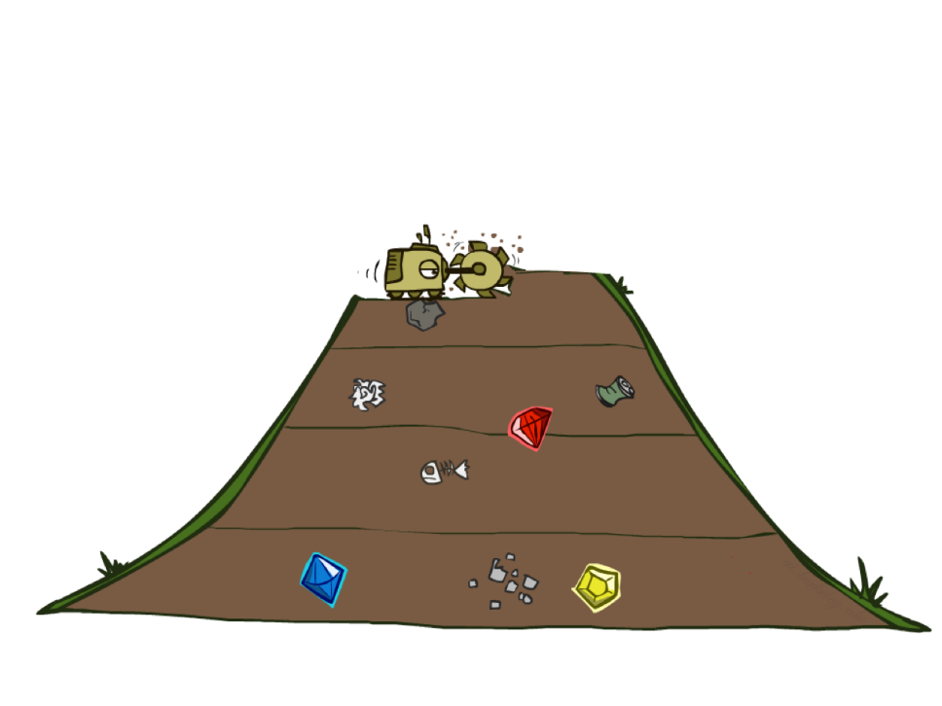
Breadth-First Search

Slide 43
Breadth-First Search
Strategy: expand a shallowest node first
Implementation: Fringe is a FIFO queue
a
G
b
c
d
e
f
S
h
p
q
r
S
d
e
p
Search
Tiers
b
c
e
h
r
q
a
a
h
r
p
q
f
p
q
f
q
c
G
q
c
G
a
a
Notes:
Same general algorithm. Shallowest node.
S D E P B C E H R Q

Slide 44
Breadth-First Search (BFS) Properties
What nodes does BFS expand?
Processes all nodes above shallowest solution
Let depth of shallowest solution be s
Search takes time O(b^{s})
How much space does the fringe take?
Has roughly the last tier, so O(b^{s})
Is it complete?
s must be finite if a solution exists
Is it optimal?
Only if costs are all 1 (more on costs later)
1 node
b
…
b nodes
s tiers
b² nodes
b^{s} nodes
b^{m} nodes
Notes:
Tier of best solution. If on right, b^s. Exponential Big.
Prove that it is complete: assume that a solution of cost (depth) d exists. It will return the solution before exposing the d+1 layer
Prove that it is optimal: assume that a solution of cost (depth) d exists and the alg returns a solution of cost d’ > d. It will return the optimal solution before exposing the d+1 layer - contradiction

Slide 45
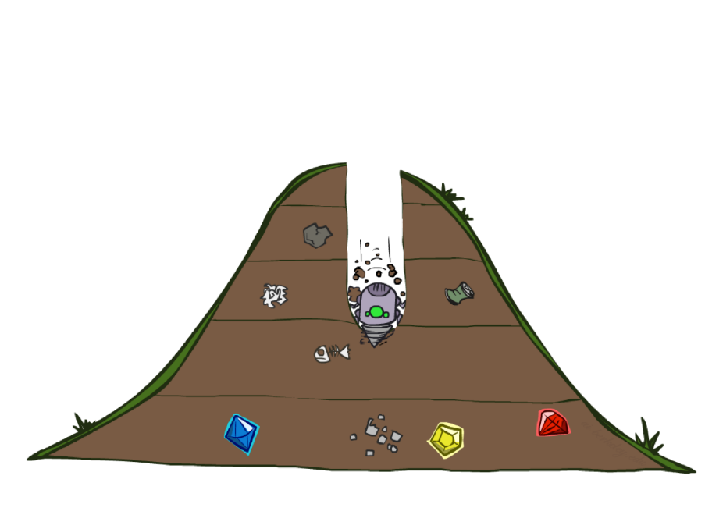
Depth-First Search

Slide 46
Depth-First Search
Strategy: expand a deepest node first
Implementation: Fringe is a LIFO stack
a
G
a
c
b
c
b
e
d
e
d
f
f
S
h
h
p
p
r
q
r
q
S
d
e
p
b
c
e
h
r
q
a
a
h
r
p
q
f
p
q
f
q
c
G
q
c
G
a
a
Notes:
S D B A C A E H P Q
Ties alphabetically in this case.

Slide 47
Depth-First Search (DFS) Properties
What nodes DFS expand?
Some left prefix of the tree.
Could process the whole tree!
If m is finite, takes time O(b^{m})
How much space does the fringe take?
Only has siblings on path to root, so O(bm)
Is it complete?
m could be infinite
To avoid this, we can call the algorithm with a bound L on the maximum depth – this is called DFS-L
Is it optimal?
No, it finds the “leftmost” solution, regardless of depth or cost
1 node
b
…
b nodes
b² nodes
m tiers
b^{m} nodes

Slide 48
Depth-First Search Variants
DFS-L
Same as DFS but with a maximum tree depth L
DFS-L-BT
Same as DFS-L but with the following modification:
At every node, we run an operator O over the same node
When we backtrack, we undo the previous operator
We only need to store one node in memory (with some additional book keeping)
1 node
b
…
b nodes
b² nodes
m tiers
b^{m} nodes

Slide 49
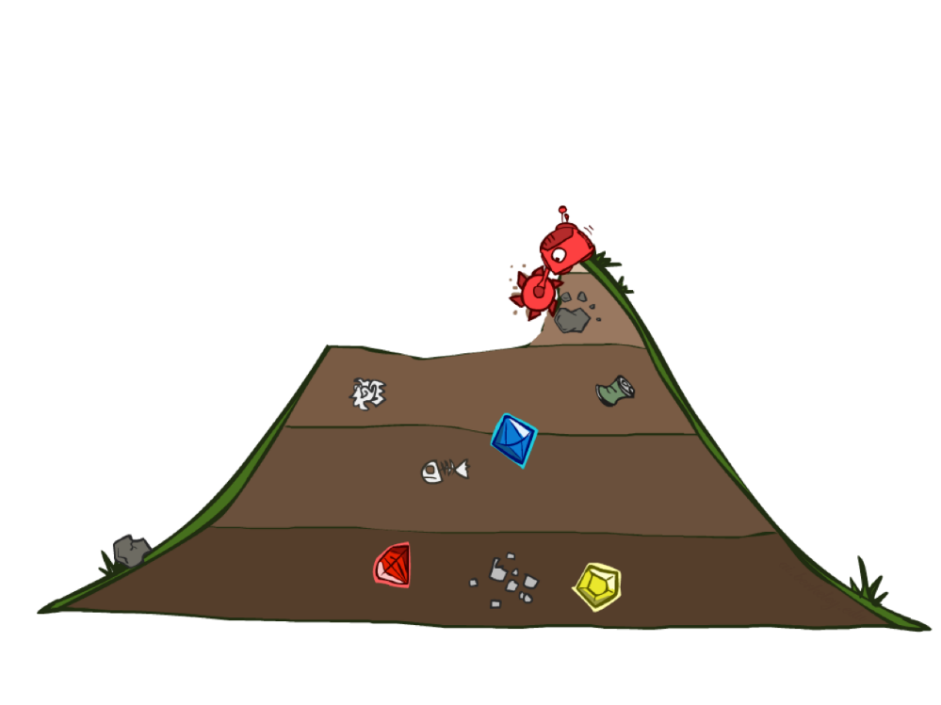
Uniform Cost Search
Notes:
Unfortunate name. It’s a “cost search” that is uniform, not a uniform cost.
Instead of depth, go by cost. Cheap things first, even if multiple actions.

Slide 50
Cost-Sensitive Search
a
GOAL
2
2
b
c
3
2
1
8
2
e
d
f
3
9
8
2
START
h
1
4
2
p
4
r
15
q
BFS finds the shortest path in terms of number of actions.
It does not find the least-cost path.
We will now cover a similar algorithm which does find the least-cost path.
Notes:
“Cost Search” What if you have costs associated with arcs?
Could you rewrite with what we already know?
Lowest number of actions S->e->r->f->G. Expensive!

Slide 51
Uniform Cost Search
2
G
a
Strategy: expand a cheapest node first:
Fringe is a priority queue (priority: cumulative cost)
b
c
1
8
2
2
e
3
d
f
9
8
2
S
h
1
1
p
q
r
15
0
S
d
3
e
9
p
1
b
4
e
5
h
17
r
11
q
16
c
11
Cost contours
a
6
a
h
13
r
7
p
q
f
p
q
f
8
q
c
G
q
c
a
11
G
10
a
Notes:
Like breadth first, but with costs. Label with cumulative cost.
Goal path not victory until try to expanded.
Contours show equal cost.

Slide 52
Uniform Cost Search (UCS) Properties
What nodes does UCS expand?
Processes all nodes with cost less than cheapest solution!
If that solution costs C* and arcs cost at least ε , then the “effective depth” is roughly C*/ε
Takes time O(b^{C*/ε}) (exponential in effective depth)
How much space does the fringe take?
Has roughly the last tier, so O(b^{C*/ε})
Is it complete?
Assuming best solution has a finite cost and minimum arc cost is positive, yes!
Is it optimal?
Yes! (Proof next lecture via A*)
b
c ≤ 1
…
C*/ε “tiers”
c ≤ 2
c ≤ 3
Notes:
Let’s say C* is 10 and minimum step size is 2. How deep in the tree? C*/e = 5. How many nodes is that?

Slide 53
Uniform Cost Issues
Remember: UCS explores increasing cost contours
The good: UCS is complete and optimal!
The bad:
Explores options in every “direction”
No information about goal location
We’ll fix that soon!
…
c ≤ 1
c ≤ 2
c ≤ 3
Start
Goal
Notes:
What if you know the goal?

Slide 54
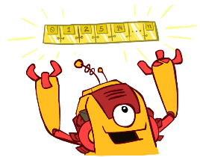
The One Queue
BFS – FIFO Queue
DFS – LIFO Queue (Stack)
UCTS – Priority Queue => log(n) overhead
All these search algorithms are the same except for fringe strategies
Conceptually, all fringes are priority queues (i.e. collections of nodes with attached priorities)
Practically, for DFS and BFS, you can avoid the log(n) overhead from an actual priority queue, by using stacks and queues
Can even code one implementation that takes a variable queuing object

Slide 55
Informed Search
Notes:
Unfortunate name. It’s a “cost search” that is uniform, not a uniform cost.
Instead of depth, go by cost. Cheap things first, even if multiple actions.

Slide 56



Search Heuristics
A heuristic is:
A function that estimates how close a state is to a goal
Designed for a particular search problem
Examples (path finding): Manhattan distance, Euclidean distance
10
5
11.2
Notes:
Function takes a state, returns a number.
Not everyday term. Not “Look both ways before you cross the street”
How far I am? Could run search, but that defeats the purpose!
Not perfect, but something!

Slide 57
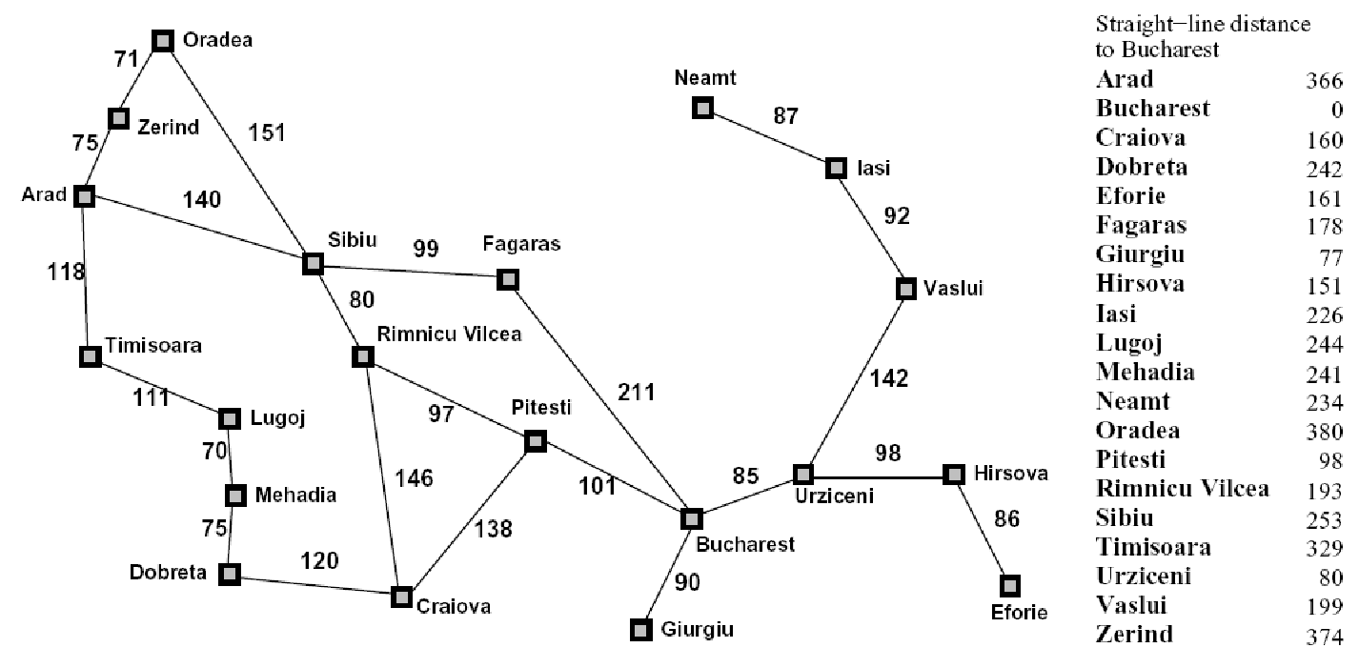
Example: Heuristic Function
h(x)
Notes:
Another heuristic. Straight line distance (as the crow flies; not as the snail crawls). Better close to Bucharest.
Not always distances, but that’s easiest to understand.
What do you do with it?

Slide 58
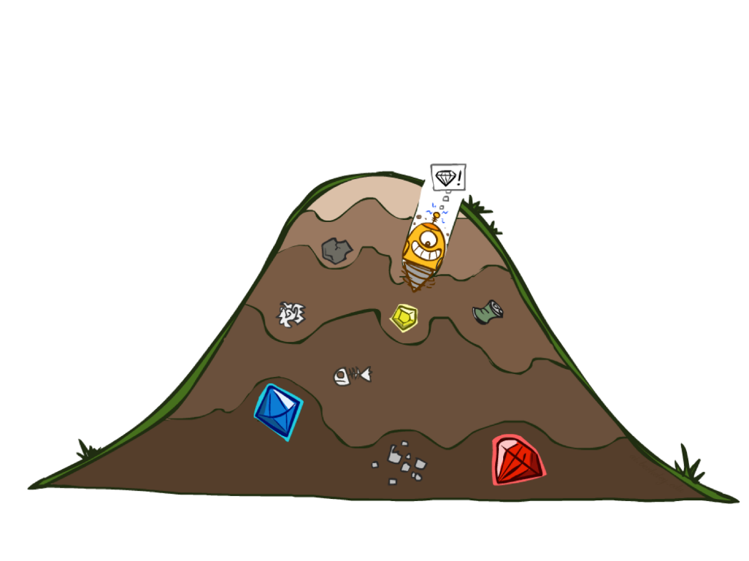
Greedy best-first Search

Slide 59
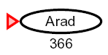
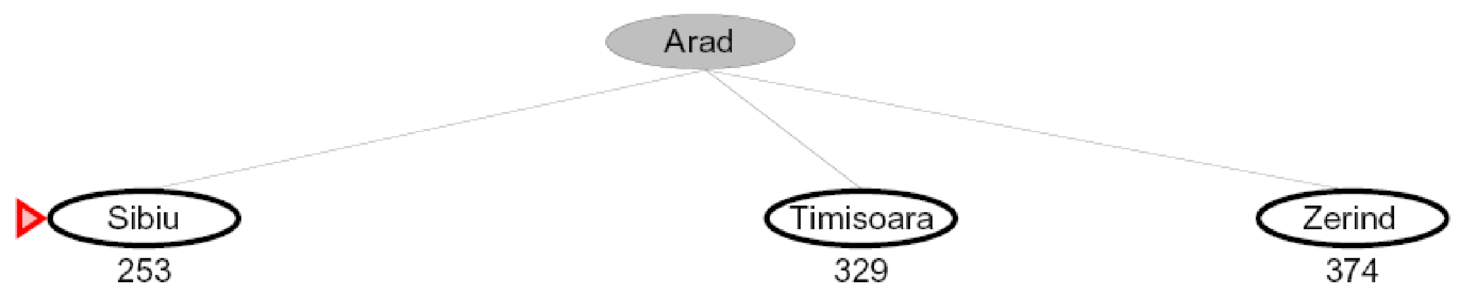
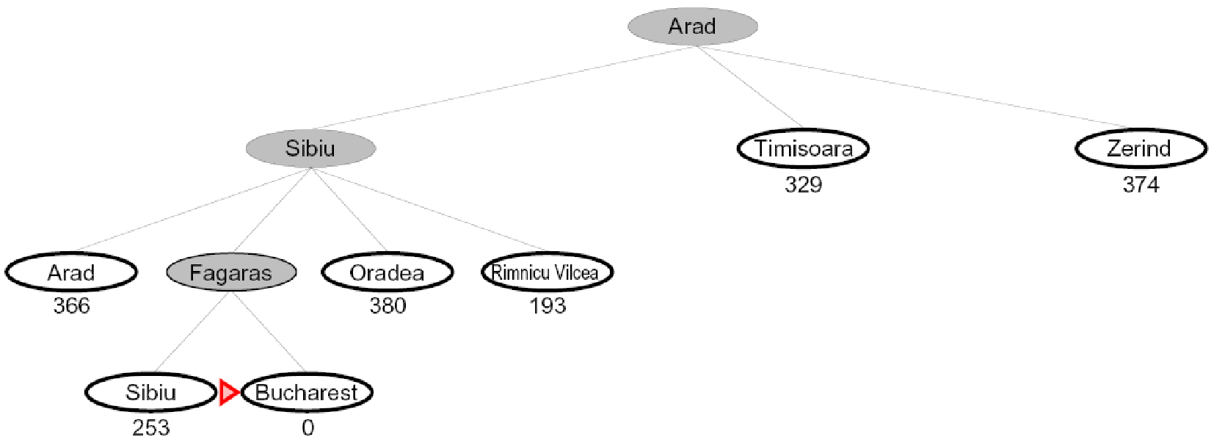
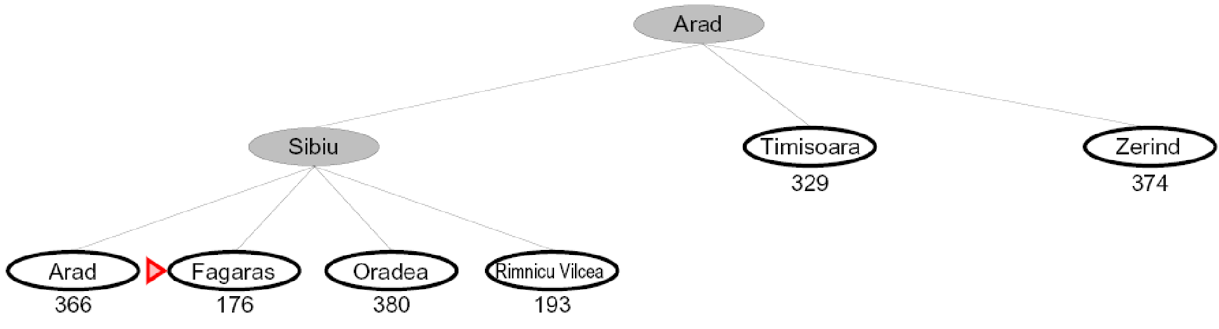
Greedy Search
h(x)
Expand the node that seems closest…
Is it optimal?
No. Resulting path to Bucharest is not the shortest!
Notes:
Numbers of heuristic, since that’s what greedy cares about.
Got to Bucharest, but not by shortest path.
End up with some kind of goal, but not what you want. You get a smelly shoe instead of to the airport on time.

Slide 60
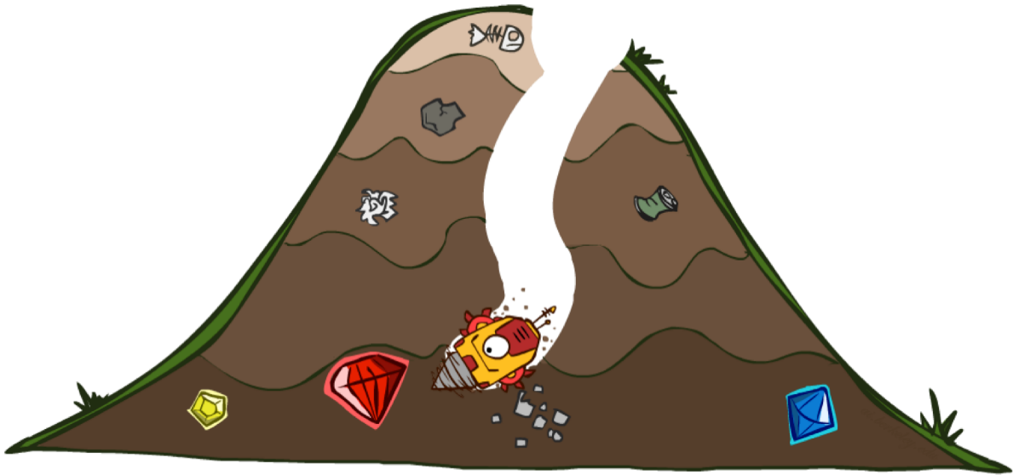
A*
Notes:
What we’ve been building to. Cornerstone. Goes to the goal like greedy, but backtracks as needed.
When it works, it’s magic!

Slide 61
Combining UCS and Greedy
Uniform-cost orders by path cost, or backward cost g(n) (aka cost-to-come)
Greedy orders by goal proximity, or forward cost h(n) (aka cost-to-go)
A* Search orders by the sum: f(n) = g(n) + h(n)
8
g = 0 h=6
S
e
h=1
g = 1 h=5
a
1
1
3
2
g = 2 h=6
g = 9 h=1
S
a
d
G
b
d
g = 4 h=2
e
h=6
1
h=5
h=2
h=0
1
g = 3 h=7
g = 6 h=0
g = 10 h=2
c
b
c
G
d
h=7
h=6
g = 12 h=0
G
Notes:
UCS: Cumulative cost of arcs back to root. backward cost g(n).
Computed as you go as part of the fringe.
Greedy: Heuristic forward cost h(n). NOT cumulative. Just a function of the state.
What is A*: Sum of the two! Doesn’t go to c early because h is high (far from goal).
Doesn’t do a->e branch g is high (expensive).

Slide 62
UCS vs A* Contours
Uniform-cost expands equally in all “directions”
A* expands mainly toward the goal, but does hedge its bets to ensure optimality
Start
Goal
Start
Goal
Notes:
~10:30

Slide 63
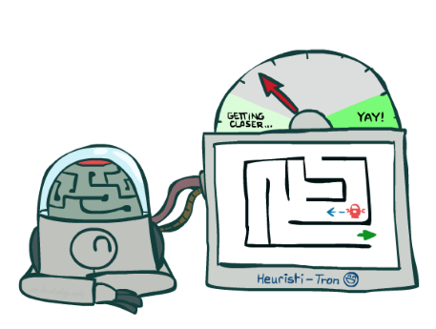
A* - optimality (admissible heuristics)
Notes:
What we’ve been building to. Cornerstone. Goes to the goal like greedy, but backtracks as needed.
When it works, it’s magic!

Slide 64


Admissible Heuristics
A heuristic h is admissible (optimistic) if:
where is the true cost to a nearest goal
Examples:
Coming up with admissible heuristics is most of what’s involved in using A* in practice.
0.0
15
11.5
Notes:
True cost – what we’re trying to solve! Need to prove beforehand.

Slide 65
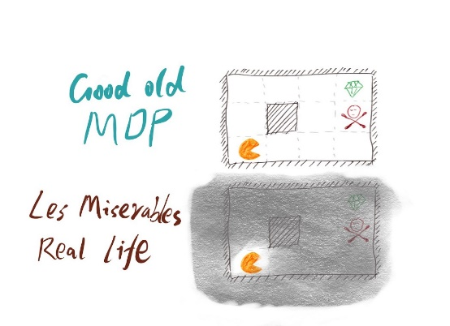
MDPs
https://medium.com/@ngao7/reinforcement-learning-model-based-adp-learner-with-code-implementation-6ad73867fb1e

Slide 66
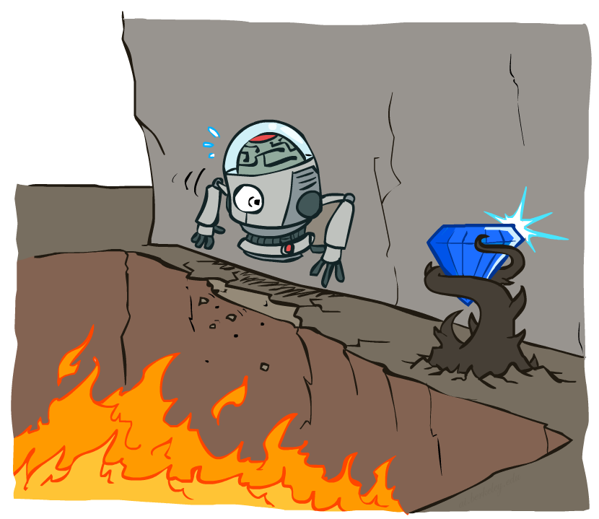
Sequential decision problems
Introduction
Utility depends on a sequence of actions
Uncertainty:
Outcomes of actions are non-deterministic
Are they observable?
Notes:
Why uncertain? Maybe robot on the ledge, what will happen?

Slide 67
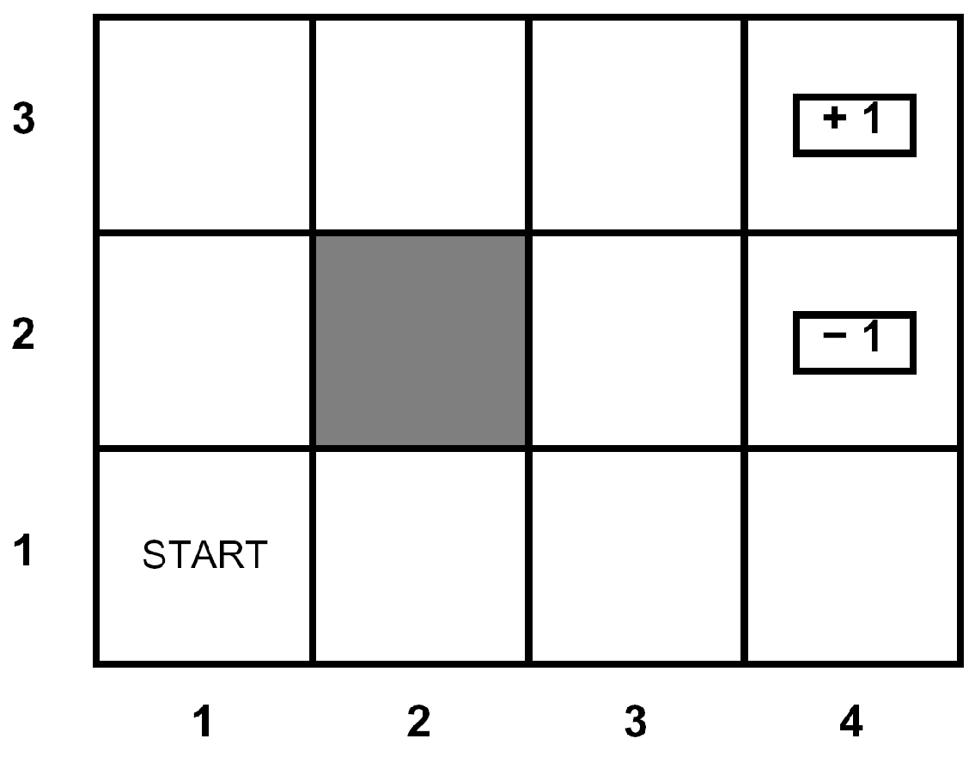





Example: Grid World
A maze-like problem
The agent lives in a grid
Walls block the agent’s path
Noisy movement: actions do not always go as planned
80% of the time, North action takes the agent North
10% of the time, North action takes the agent West
10% of the time, North action takes the agent East
If there is a wall in the direction the agent would have been taken, the agent stays put
The agent receives rewards each time step
Small “living” reward each step (can be negative)
Big rewards come at the end (good or bad)
Goal: maximize sum of rewards
Notes:
[cut demo of moving around in grid world program]
Terminal utilities + living reward (positive – get happier; neg – get sadder)
At exist state you have to exit, the game ends, and you collect terminal utility
Don’t need to have goals – maximize happiness!

Slide 68

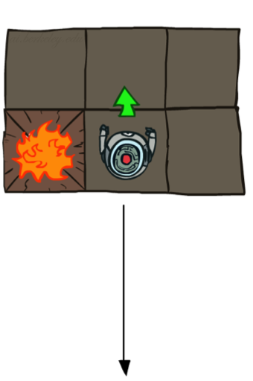
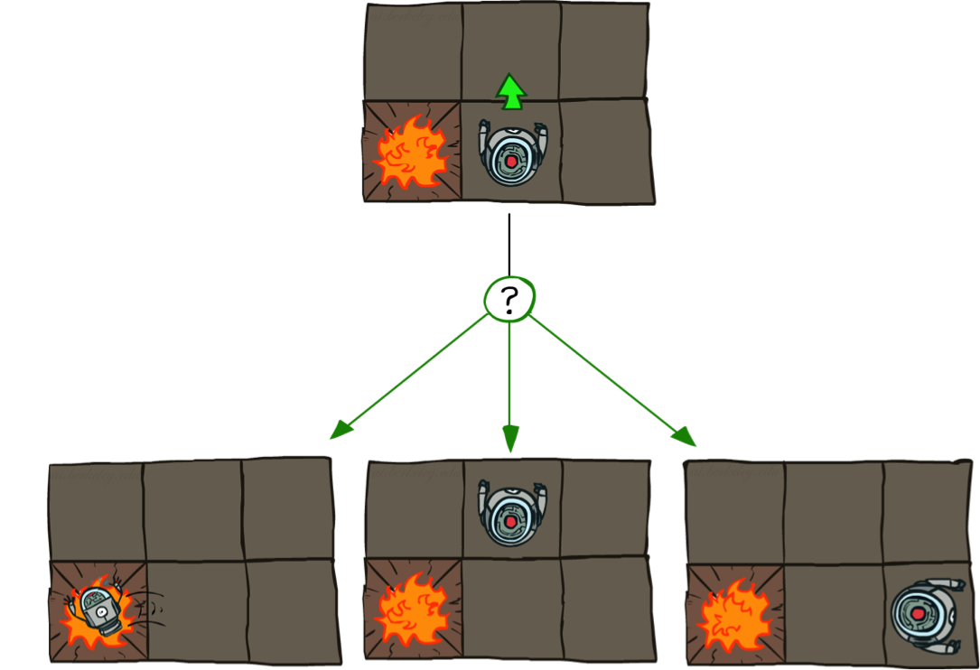

Grid World Actions
Deterministic Grid World
Stochastic Grid World
Notes:
When you plan you will have to take these into account

Slide 69
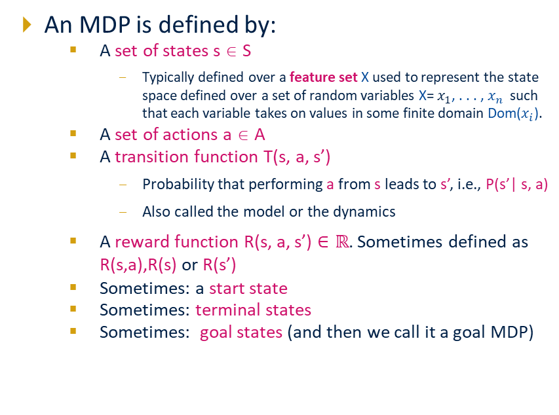
Markov Decision Processes
Notes:
In search problems: did not talk about actions, but about successor functions --- now the information inside the successor function is unpacked into actions, transitions and reward
Write out S, A, example entry in T, entry in R; note: T has to some up to 1 over all s’s
Reward function different from the book : R(s,a,s’)
In book simpler for equations, but not useful for the projects.
Need to modify expectimax a tiny little bit to account for rewards along the way, but that’s something you should be able to do, and so you can already solve MDP’s (not in most efficient way)

Slide 70
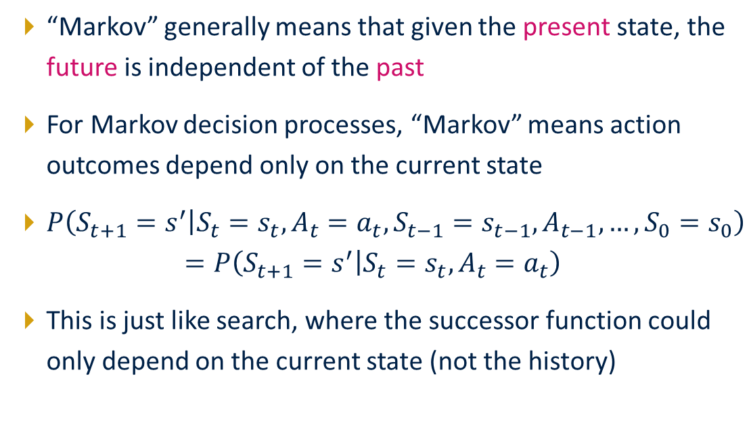
What is Markov about MDPs?
Andrey Markov (1856-1922)
Notes:
Like search: successor function only depended on current state
Can make this happen by stuffing more into the state;
Very similar to search problems: when solving a maze with food pellets, we stored which food pellets were eaten!

Slide 71

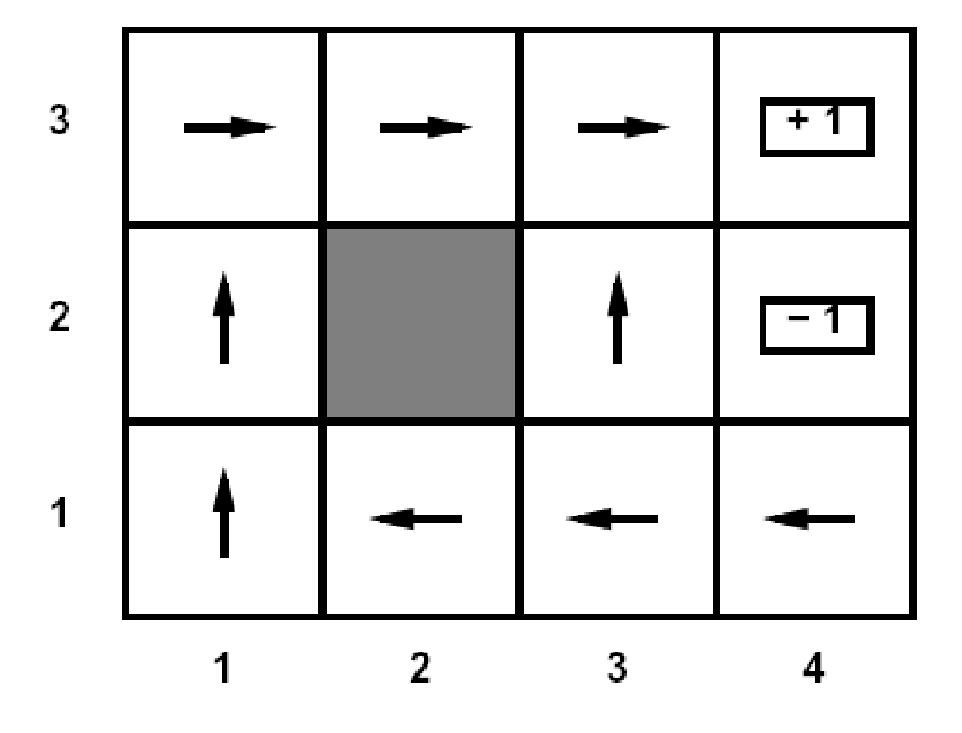
Policies
In deterministic single-agent search problems, we wanted an optimal plan, or sequence of actions, from start to a goal
For MDPs, we want an optimal
policy π*: S → A
A policy π gives an action for each state
An optimal policy is one that maximizes expected utility if followed
Optimal policy when R(s, a, s’) = -0.03 for all non-terminals s

Slide 72
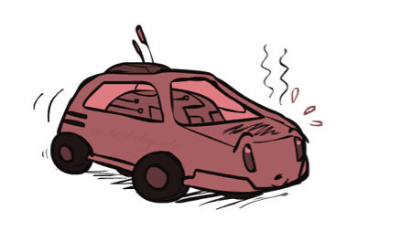
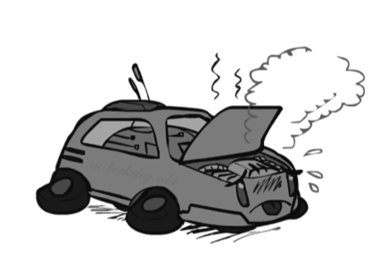
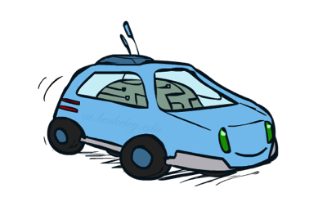
Example: Racing
A robot car wants to travel far, quickly
Three states: Cool, Warm, Overheated
Two actions: Slow, Fast
Going faster gets double reward
0.5
+1
1.0
Fast
Slow
-10
+1
0.5
Warm
Slow
Fast
0.5
+2
Cool
0.5
Overheated
+1
1.0
+2
Notes:
-10 and the game ends (important that the game ends because regardless you never want to do it)

Slide 73
Recap: Defining MDPs
Markov decision processes:
Set of states S
Set of actions A
Transitions P(s’|s,a) (or T(s,a,s’) )
Rewards R(s,a,s’) (and discount γ)
Sometimes: a start state s₀
Sometimes: terminal states
Sometimes: goal states (and then we call it a goal MDP)
MDP quantities so far:
Policy = Choice of action for each state
Utility = Sum of (discounted) rewards
s
a
s, a
s,a,s’
s’

Slide 74
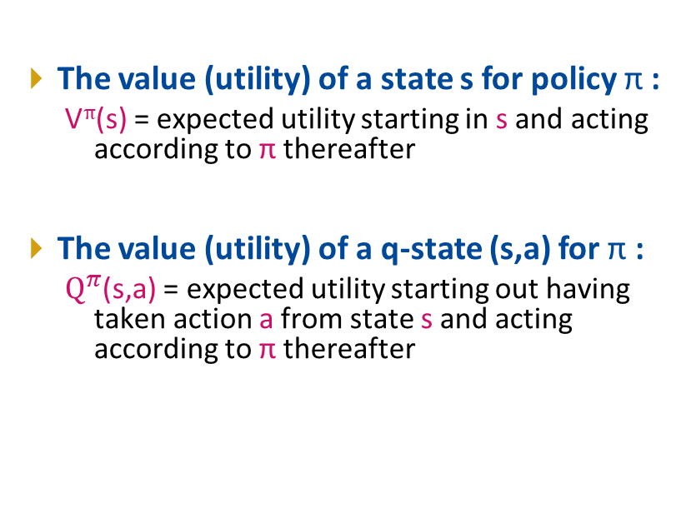
Value for a given policy
s
s is a state
a
(s, a) is a q-state
s, a
s,a,s’
(s,a,s’) is a transition
s’
Notes:
[Note: this demo doesn’t show anything in action, just pops up V and Q values.]

Slide 75
Optimal Quantities
An optimal policy:
π*(s) = optimal action from state s
The optimal value (utility) of a state s:
V*(s) = expected utility starting in s and acting optimally
The optimal value (utility) of a q-state (s,a):
Q*(s,a) = expected utility starting out having taken action a from state s and (thereafter) acting optimally
s
s is a state
a
(s, a) is a q-state
s, a
s,a,s’
(s,a,s’) is a transition
s’
Notes:
[Note: this demo doesn’t show anything in action, just pops up V and Q values.]

Slide 76
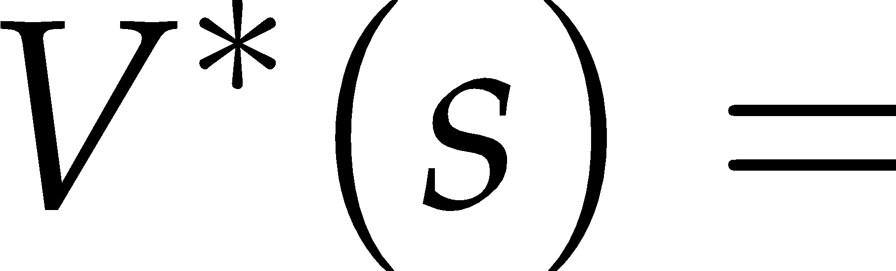

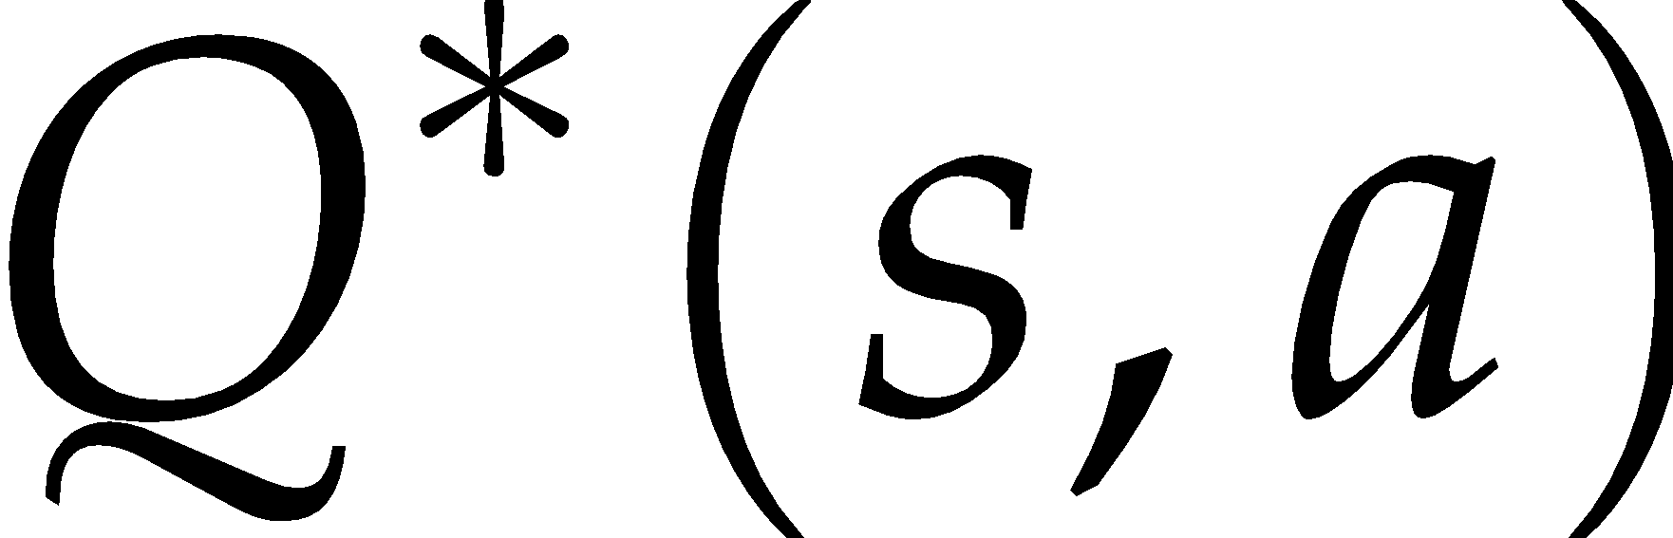

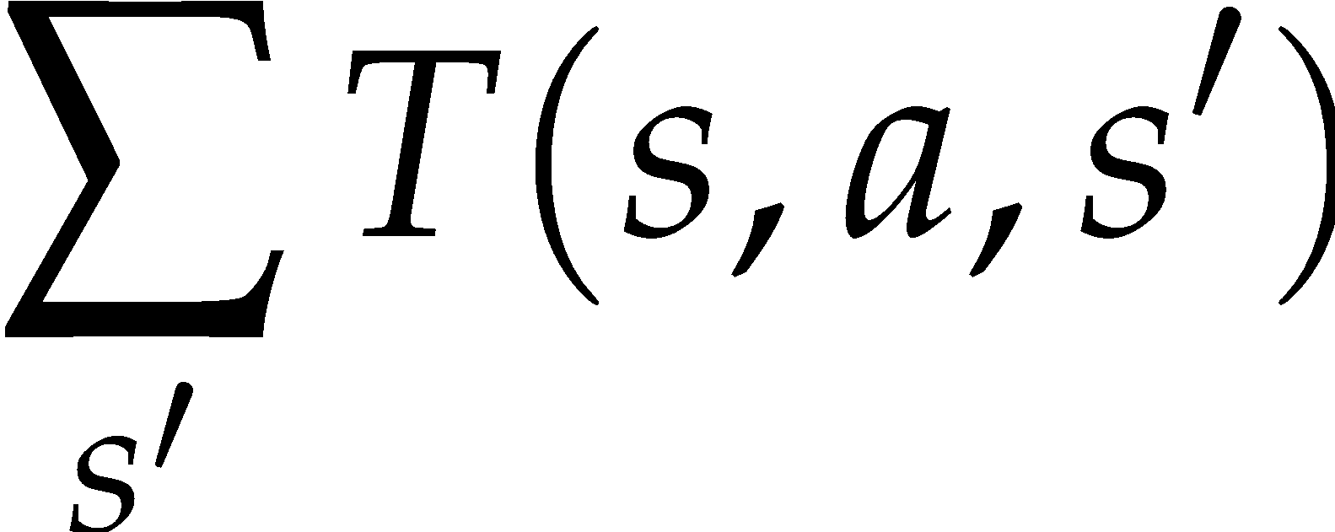

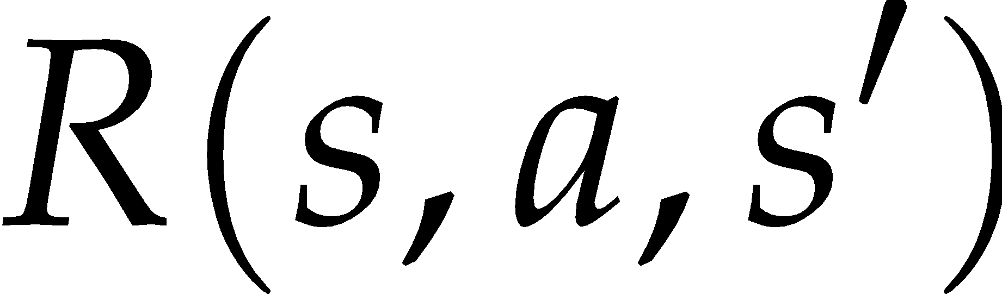

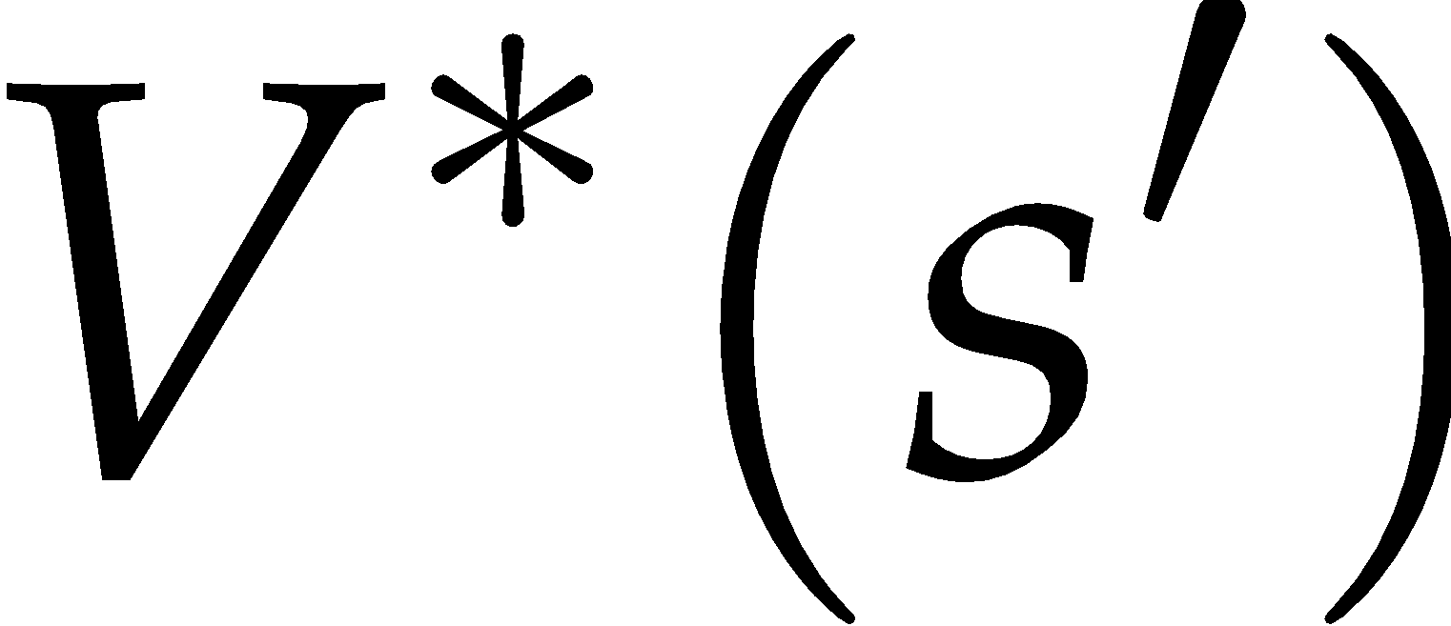


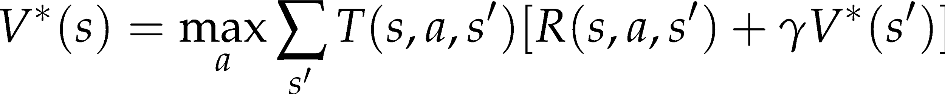
Values of States
L7
Recursive definition of value:
s
a
s, a
s,a,s’
s’

Slide 77
MDP Algorithms
L7
So you want to….
Compute optimal values: use value iteration or policy iteration
Compute values for a particular policy: use policy evaluation
Turn your values into a policy: use policy extraction (one-step lookahead)
These all look the same!
They basically are – they are all variations of Bellman updates
They all use one-step lookahead expectimax fragments
They differ only in whether we plug in a fixed policy or max over actions

Slide 78
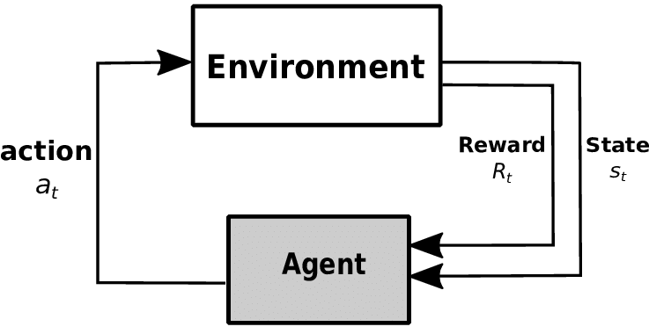
Problem Definition
Assuming the world behaves (and can be modeled) as an MDP (restrictive?)
The agent has partial or no knowledge of environment, but can act in the world and observe states and reward
Find a policy that maximizes expected utility

